Slide 1
Kidney disease assessment
Emad abokhbar
Lecturer of internal medicine and nephrology
Sohag university

Slide 2
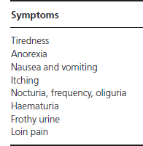
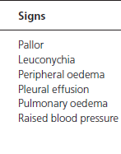
History and clinical examination

Slide 3
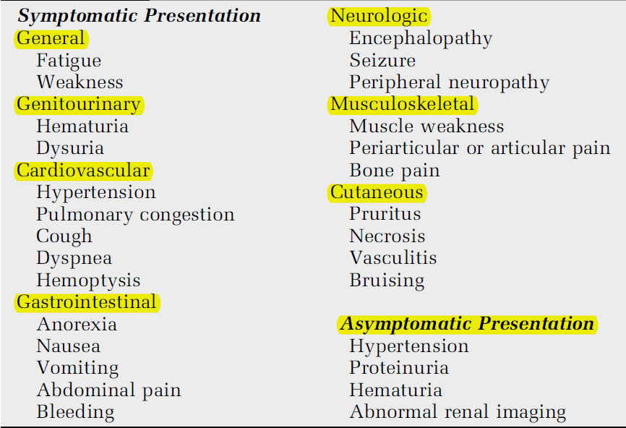
RENAL MANIFESTATIONS

Slide 4
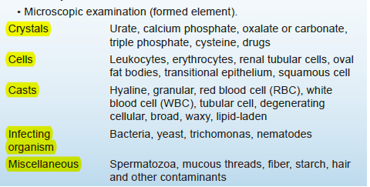
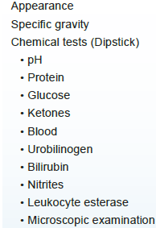
Urine examination

Slide 5
Urine output

Slide 6
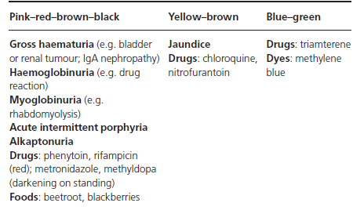
URINE

Slide 7
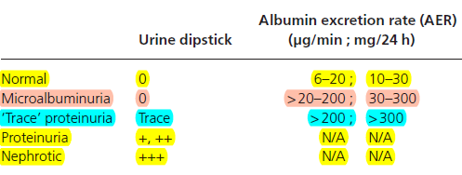
Proteinuria

Slide 8
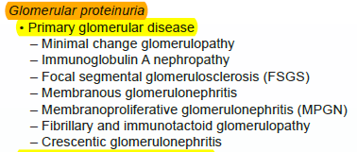
Proteinuria

Slide 9
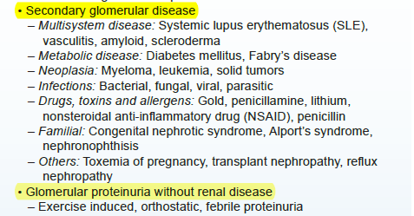
Proteinuria

Slide 10
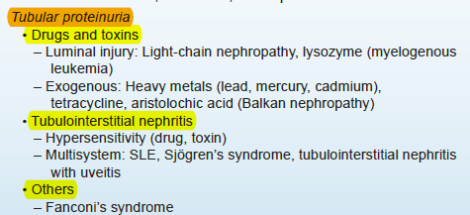
Proteinuria

Slide 11
Proteinuria

Slide 12
Hematuria

Slide 13
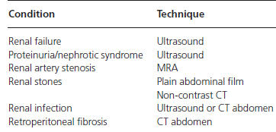
RENAL IMAGES

Slide 14
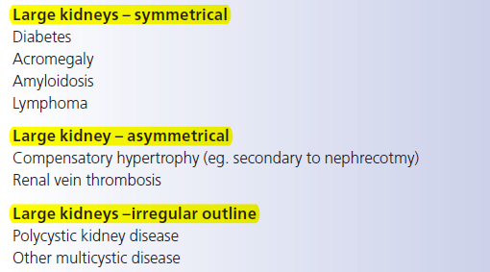
Renal images

Slide 15
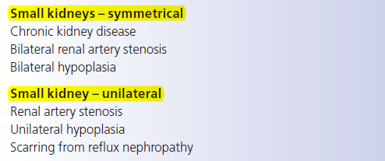
Renal images

Slide 16
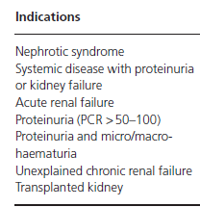
RENAL BIOPSY

Slide 17
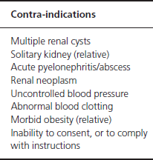
RENAL BIOPSY

Slide 18
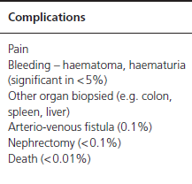
RENAL BIOPSY

Slide 19
Renal function tests
Serum creatinin 0.5-1.2 mg
Blood urea
Serum Cystatine C
GFR (glomerular filtration rate)
Creatinin clearance

Slide 20
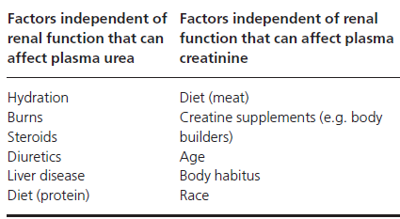
Renal functions

Slide 21
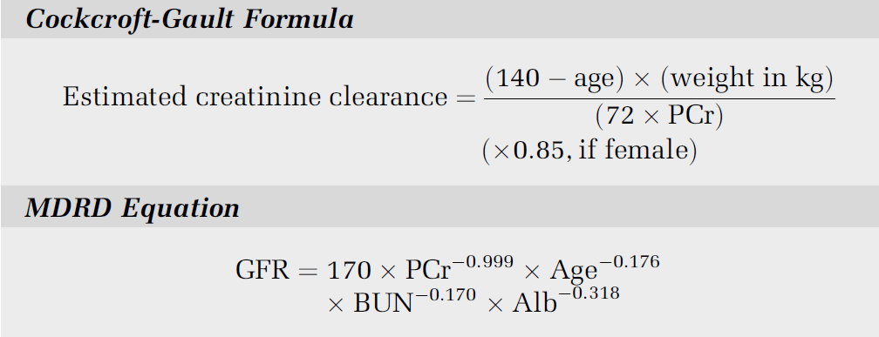
GFR MEASURMENT

Slide 22
GFR MEASURMENT
Radiocontrast and radionuclide markers

